Slide 1
INFO 341 Subnetting Primer
By
Bob Larson

Slide 2
Topics
Why do we subnet?
Classful vs. Classless Subnetting
Math Behind Conversion Table
Subnetting as Bits
Planning Your Network
Five simple steps to create your subnets
Examples

Slide 3
Why do we subnet?
Could be:
Floors
Departments
Buildings
Locations
Regions
Cruise ships
A - 50
B - 120
Router
C - 12
To set up logical divisions
Improved network security
Improved network performance
More or fewer IP addresses required per subnet

Slide 4
When you don’t need or know subnetting
All nets using 255.255.255.0 subnet mask
Internet
Router Building 1
Router Building 2
Router Building 3
192.168.4.1
192.168.5.1
192.168.4.2
192.168.5.2
192.168.1.1
192.168.2.1
192.168.3.1
192.168.1.0 Network
192.168.2.0 Network
192.168.3.0 Network
Switch
Switch
Switch
192.168.1.12
.15
.62
.197
192.168.2.7
.15
.45
.251
192.168.3.12
.101
.210
.253

Slide 5
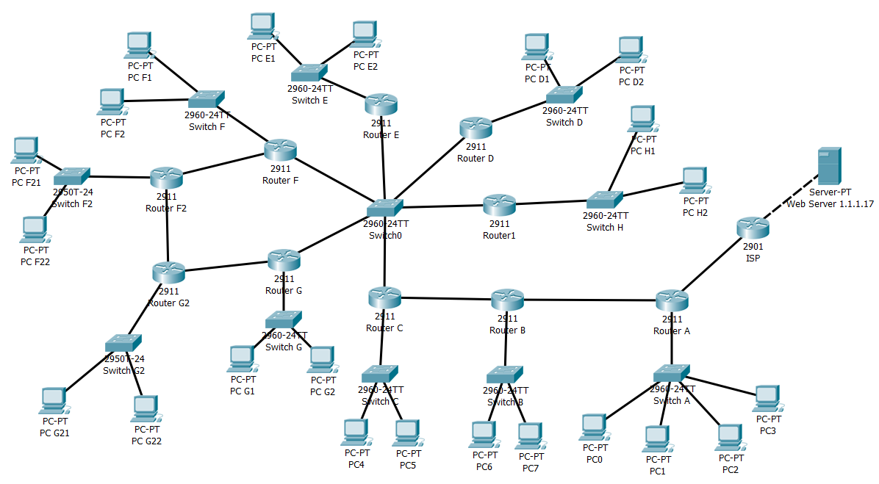
How many networks here?

Slide 6
How many networks here?
14
15
13
12
11
17
16
10
9
1
5
3
7
8
6
4
2

Slide 7
Classful vs. Classless Subnetting
Classful Subnetting
Default Masks
A 255.0.0.0
B 255.255.0.0
C 255.255.255.0
010.100.200.123 IP Address 255.255.255.000 Mask
Default Mask
Subnet Mask
Classless Subnetting
010.100.200.123 IP Address 255.255.255.000 Mask
CIDR Classless Interdomain Routing
CIDR notation: /n n = number of bits
255.255.255.0 = /24
Subnet Mask

Slide 8
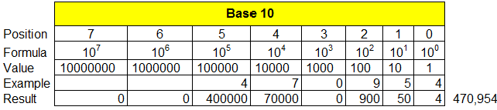
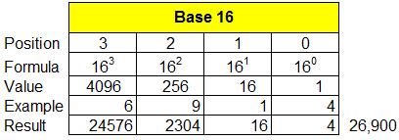
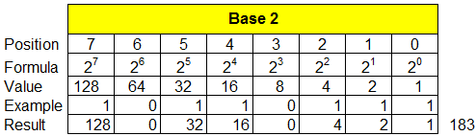
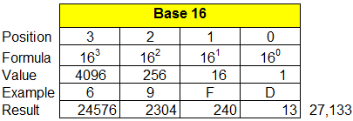
Math Behind Conversion Table
0123456789
11
13
15
0123456789ABCDEF
01

Slide 9
Analogy of Subnetting
256 Total IPs
You will be given a pie of a certain size
The subnet mask (net mask) is the size
/24 or 255.255.255.0 = 256 addresses (254 usable)
/22 or 255.255.252.0 = 1,024 addresses (1,022 usable)
/26 or 255.255.255.192 = 64 addresses (62 usable)
Each subnet must cut the piece in half (2 equal pieces)
Each piece will have half as many addresses
Less 2: One for the network ID, One for the Broadcast ID
64 IPs
62 Hosts
128 IPs
126 Hosts
32 IPs
30 Hosts
16 IPs
14 Hosts

Slide 10
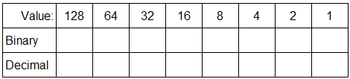
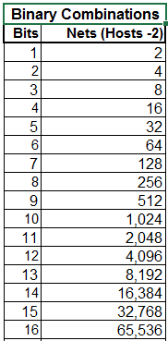
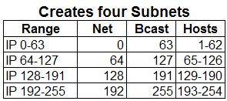
Add Two-Bits to the Subnet
Network
Host
192.168.001.123 IP Address 255.255.255.192 Subnet mask
Increment: 64 addresses
11000000.10101000.00000001.01111011 IP Address (Binary)
11111111.11111111.11111111.11000000 Subnet mask (Binary)
----------------------------------------------------------------------------------------
11000000.10101000.00000001.01000000 Network ID (Binary)
11000000.10101000.00000001.01111111 Broadcast (Binary)
192.168.001.64 Network ID 192.168.001.65 First host address
192.168.001.126 Last host address
192.168.001.127 Broadcast

Slide 11
Add Seven-Bits to the Subnet
Network
Host
192.168.001.123 IP Address 255.255.255.254 Subnet mask
11000000.10101000.00000001.01111011 IP Address (Binary)
11111111.11111111.11111111.11111110 Subnet mask (Binary)
----------------------------------------------------------------------------------------
11000000.10101000.00000001.01111010 Network ID (Binary)
11000000.10101000.00000001.01111011 Broadcast (Binary)
192.168.001.122 Network ID 192.168.001.X First host address
192.168.001.X Last host address
192.168.001.123 Broadcast
Creates 128 Subnets with 2 addresses each

Slide 12
Subtract One Bits from the Subnet
Network
Host
192.168.001.123 IP Address 255.255.254.0 Subnet mask
11000000.10101000.00000001.01111011 IP Address (Binary)
11111111.11111111.11111110.00000000 Subnet mask (Binary)
----------------------------------------------------------------------------------------
11000000.10101000.00000000.00000000 Network ID (Binary)
11000000.10101000.00000001.11111011 Broadcast (Binary)
192.168.000.0 Network ID 192.168.000.1 First host address
192.168.001.254 Last host address
192.168.001.255 Broadcast
Creates 1 Subnet with 512 addresses. Often then subnetted later.

Slide 13
Planning Your Network
Your requirements can come in three forms:
You need a certain number of subnets.
You need a certain number of hosts per subnet.
A combination of both—the most common.
Two things to remember:
Address pools (subnets) can’t overlap.
Start with the largest subnet and work to the smallest.

Slide 14
Five simple steps to create your subnets
A - 50
B - 120
Router
C - 12
Figure out how many host subnets you need.
Rank them largest to smallest.
How many host bits will be needed for the largest network?
Choose the subnet for the largest network.
Note the address range to use, so you don’t overlap later.
Repeat steps 2–4 for the next largest subnet until done.

Slide 15
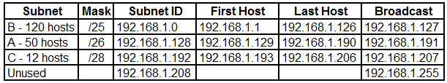
Subnet Example 1
A - 50
B - 120
Router
C - 12

Slide 16
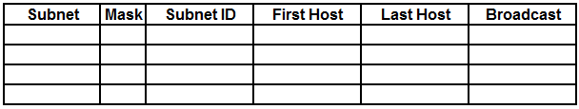
Subnet Example 2
A - 50
B - 60
Router
C - 40

Slide 17
Subnet Example 3
A - 35
B - 45
Router
C - 55

Slide 18
Fin…

